Slide 1



Overview of the Recommendations for a standard on corporate biodiversity measurement and valuation
An e-learning module from the Align project

Slide 2
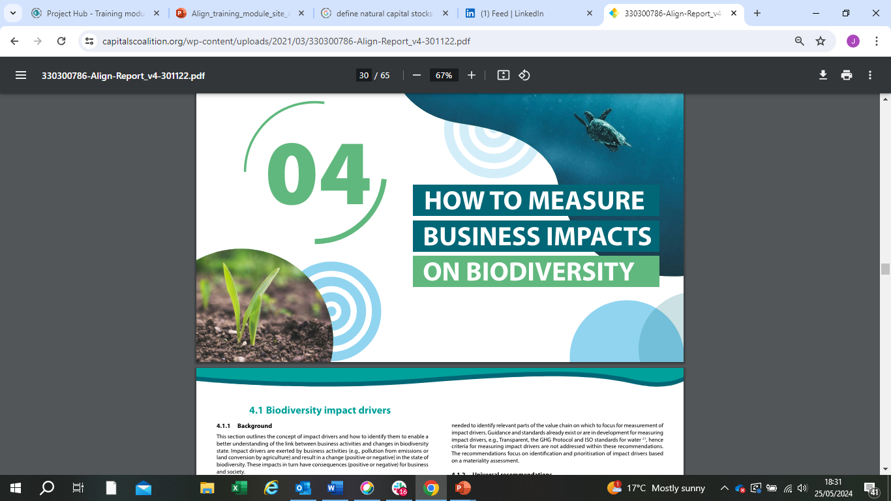
These materials have been prepared for the European Commission however they reflect the views only of the
authors, and the Commission cannot be held responsible for any use which may be made of the information contained therein.
© European Union, 2024.
The reproduction and reuse of these materials is authorized, provided its source is acknowledged and the original meaning or message of the texts are not distorted. The European Union shall not be liable for any consequence stemming from the reuse.

Slide 3
The Align project – Aligning accounting approaches for nature - came into being with the objective to co-develop recommendations for a standard on corporate biodiversity measurements and valuation. Align aims to provide businesses and financial institutions with principles and criteria for biodiversity measurement and valuation.
The Align project is funded by the European Commission. It is led by UNEP-WCMC, the Capitals Coalition, Arcadis and ICF with the support of WCMC Europe.
https://capitalscoalition.org/project/align/
https://green-business.ec.europa.eu/business-and-biodiversity/our-activities/align_en
Notes:
Welcome to this module on an introduction to the recommendations on measurement and valuation, prepared by the Align project.

Slide 4

Who is this module for?
This short introductory module is aimed at diverse users, including sustainability managers within companies, corporate method developers and standard setters, and policy makers. Whilst a basic understanding of nature issues is expected, the module aims to provide a general overview of the main concepts included in the Align project recommendations, the core output of the Aligning accounting approaches for nature project.
Two further training modules, deep diving into specific topics of site level accounting and supply chain foot printing have been developed by the project, including accompanying activities.

Slide 5

The Align Recommendations
Published in December 2022:
Recommendations for a standard on corporate biodiversity measurement and valuation
https://capitalscoalition.org/project/align/
Notes:
There is an urgent need to provide an agreed set of principles and technical criteria setting out ‘what’ elements of biodiversity should be measured and valued and ‘how’ this should be done in different decision-making contexts. The Align project - Aligning accounting approaches for nature - came into life with the objective to co-develop recommendations for a standard on corporate biodiversity measurements and valuation. Align aimed at providing businesses and financial institutions with principles and criteria for biodiversity measurement and valuation. The Align project was funded by the European Commission, and led by UNEP-WCMC, the Capitals Coalition, Arcadis, and ICF, with the support of WCMC Europe. The Align project recommendations for a standard on corporate biodiversity measurement and valuation (the Align recommendations in short) were published in December 2022 and set out a ‘journey towards corporate biodiversity accounting’. The recommendations can be downloaded from the Align website.

Slide 6
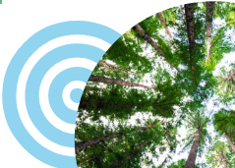
Part 1- Decision making contexts
Part 2- Metrics and impact measurement approaches
Part 3-
A) Dependencies
B) Valuation of impacts and dependencies

Slide 7

Learning objectives
Gain an overview of the Align recommendations and the core concepts of screening and measuring impacts, as well as assessing dependencies and valuation.
Learn the factors to consider in selecting a measurement approach including spatial precision, accuracy, responsiveness to change and feasibility to apply at scale.
Notes:
The module has 2 core learning objectives.

Slide 8
Decision making contexts
Notes:
In this section, we will explore the different decision making context measurement approaches can support. It is important to understand the decision making context to select appropriate methods.

Slide 9
Main organisational focus areas covered by the recommendations
Site or project level
Existing sites, planned undertakings at a specific location, directly related to the site or project activities
Supply chain
Focus is on the upstream parts of the value chain where primary sectors are active
Product level
Not the focus of the Align project (goods and/or services)
Corporate-level aggregated impacts
Not the focus of the Align project (assessment of a corporation or group)
Notes:
Organisational focus areas are defined as the part or parts of the business for which biodiversity measurement will be undertaken, e.g. the company as a whole, a business unit, product, project or portfolio.
The Align recommendations outline four main organizational focus areas: site or project level, supply chain, product level and corporate level.
The Align technical criteria focus on the first two:
Site or project level: site level usually refers to existing sites while project level usually refers to planned undertakings or initiatives at a specific location; site and project level impacts are directly related to the site or project activities, processes, and incidents and exclude supply chains delivering to the site or project.
Supply chain: focus is on the upstream parts of the value chain where primary sectors are active (e.g. extraction of raw materials, agriculture, fisheries, forestry).

Slide 10
3 core clusters of business application
Screening of risks related to potential impacts and dependencies, and opportunities for mitigation
Requires less detailed measurement approaches. Might have qualitative outcomes.
Measuring actual biodiversity impacts and performance
Requires more precise quantified figures to understand change in biodiversity state
Measuring changes in the state of biodiversity underpinning business dependencies on ecosystem services
Requires quantitative measures of the state of biodiversity
Notes:
The business application is defined as the intended use of the results of a measurement process, to help inform decision-making
Three clusters of business applications are considered from a measurement perspective:
1.Screening of risks related to potential impacts and dependencies, and opportunities for mitigation; it requires less detailed measurement approaches and might even have qualitative outcomes; outputs are indicative in nature but sufficient for prioritisation purposes.
2.Measuring actual (as opposed to ‘potential’) biodiversity impacts and performance; this requires more precise, quantified figures to understand the change in biodiversity state that is observed or predicted based on a company’s activities.
3.Measuring changes in the state of biodiversity underpinning business dependencies. This requires quantitative measures of the state of biodiversity and the provision of ecosystem services on which the business activity depends.

Slide 11
Example roles of screening in decision making
Screening of biodiversity risks and mitigation opportunities
Site/Project | Identifying and assessing potential material biodiversity issues at site level
 | Comparing alternative sites based on biodiversity risk (e.g. criterion for site selection)
 | Ranking of existing sites based on biodiversity risk (e.g. for prioritising more in-depth measurement)
 | Identification of potential mitigation measures that can be implemented at existing/site project or can be integrated in the design and construction of new site project
Supply chain | Identifying and assessing potential material biodiversity within supply chains
 | Comparing biodiversity risks among commodities or different sourcing regions
 | Developing engagement strategies with suppliers (as an opportunity for increasing biodiversity performance in supply chains)
 | Assessing whether a certification scheme or other requirement will address the likely biodiversity risks in supply chains
Notes:
In turn ‘screening’ can support decisions at both site and supply chain level.

Slide 12
Role of measurement in decision making
Measuring biodiversity impacts
Site/Project | Understanding the current biodiversity impact of existing sites/project which allows: Prioritisation of mitigation measures (e.g. specific sites/project or among sites/projects) Monitoring effectiveness of mitigation measures Demonstrating continuous improvement over time to target (e.g. no net loss or net positive) Assessing progress over time Estimating the predicted biodiversity gains in offset areas Monitoring losses and gains of biodiversity and calculating the balance, as part of a no net loss or net positive ambition
Supply chain | Comparing biodiversity impacts among commodities or different sourcing regions and sites
 | Measuring impacts of sourced commodities identified as material and effectiveness of mitigation measures
 | Developing engagement strategies with suppliers (as an opportunity for increasing biodiversity performance in supply chains)
Notes:
And similarly, measuring actual impacts supports’ can support decisions at both site and supply chain level.

Slide 13

Content check-in
What of the following statements is true regarding screening and measuring impacts?
A. Screening impacts always requires more precise and granular measurement than measuring actual impacts
B. Measuring impacts likely requires more precise and granular measurement than screening potential impacts
C. Both screening and measuring impacts must always result in quantitative measurements

Slide 14
Content check-in
What of the following statements is true regarding screening and measuring impacts?
A. Screening impacts always requires more precise and granular measurement than measuring actual impacts
B. Measuring impacts likely requires more precise and granular measurement than screening potential impacts
C. Both screening and measuring impacts must always result in quantitative measurements
Notes:
Did you get it right? Moving from screening to measuring actual impacts likely requires more granular and detailed measurement approaches.

Slide 15
Metrics and impact measurement approaches
Notes:
In this section, we will explore the different types of metrics and measurement approaches for assessing impacts on biodiversity.

Slide 16
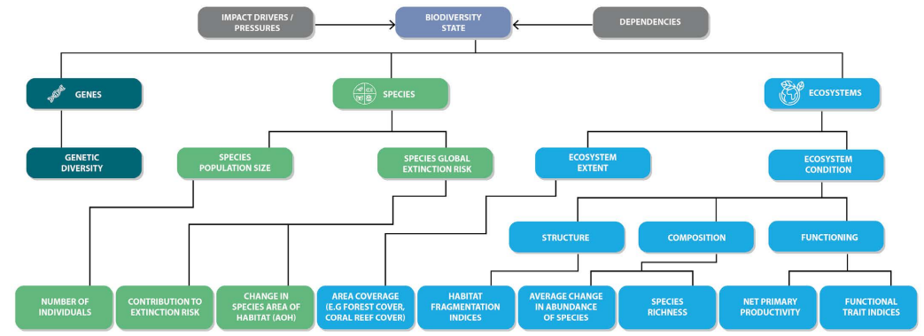
Components of biodiversity
Source: the Align recommendations
Notes:
Biodiversity is composed of ecosystems, species, and genes. Each will have a different aspects that can be acted upon, and measured.
Ecosystems: There are two aspects to consider for the biotic component of ecosystems – extent and condition. Ecosystem condition (also referred to as integrity) can be assessed through measuring elements including composition of ecological communities, ecosystem structure, here including spatial structure of patches at the landscape level, and ecosystem functioning.
Species. Specific for species, there are two aspects to consider: population size and extinction risk. These provide insight on the health of a single species’ population and its relative resilience to human induced and naturally occurring change.
Genes: Genes have one aspect to consider, genetic diversity. Genetic diversity describes the variability in genetic characteristics within a given species, or within an ecosystem, and provides an indication of its resilience to change. There is a lack of tools available to measure genetic diversity.

Slide 17
Content check-in
‘Net Primary Productivity’ is an example of a metric that assesses what aspect of biodiversity?’
A. Species population size
B. Ecosystem extent
C. Ecosystem condition

Slide 18
Content check-in
‘Net Primary Productivity’ is an example of a metric that assesses what aspect of biodiversity?’
A. Species population size
B. Ecosystem extent
C. Ecosystem condition
Notes:
Did you get it right? Primary productivity is a function of an ecosystem, so is a measure of ecosystem condition

Slide 19
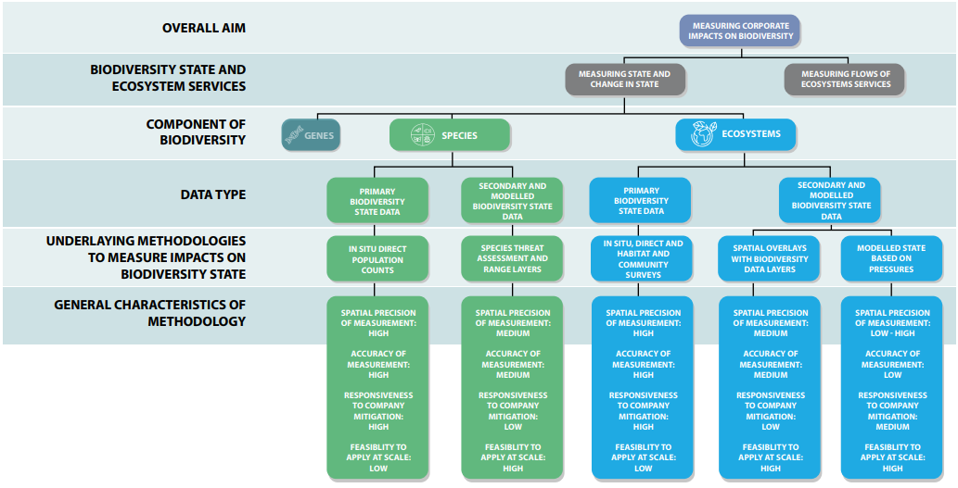
Typology of measurement methods
Assuming good quality data is collected and used
General characteristics of each methodology is assessed and discussed in the next slides
Source: the Align recommendations
Notes:
Corporate measurement of impacts on biodiversity can measure the state of biodiversity and/or flows of ecosystem services. Within the Align recommendations, the focus is on measuring the state of biodiversity and the changes in this state. The recommendations provide a typology of measurement methods and their characteristics. Accompanying the typology is a set of technical criteria and underlying data requirements for implementation. Adhering to the technical criteria is critical for ensuring the chosen methodology accurately reflects changes to biodiversity state.
The type of data used should be considered when interpreting the results. For example, primary and secondary biodiversity state data are most likely to provide an estimate of actual impact to biodiversity state. It is important to note that directly collected primary data based on sampling will still be measured with a degree of error and variability and depends on the sampling approach used. In the absence of any ground-truthing or use of primary state data, model-based approaches provide only an estimate of potential impact, rather than measuring actual impact.

Slide 20
Data types
Primary data
Collected in situ
From primary sources: using ‘on the ground’ surveys, remote sensing, eDNA, bioacoustics, …
Secondary state data:
Already available data that has been collected for broader purpose
E.g. geospatial data layers (via models or through remote sensing)
Example species: threat status
Example ecosystem: levels of habitat fragmentation and connectivity
Modelled pressure-state data:
Based on model
More accurate when using directly measured primary pressure data vs sector averages to feed the model
Source: the Align recommendations
Notes:
Methodologies available to collect data and measure indicators of biodiversity state can be separated into three categories: primary data, secondary data and modelled data. These categories are not mutually exclusive and can be combined within a measurement approach.
Primary biodiversity state data: collected in-situ for the purpose of the assessment using ‘on the ground’ surveys or remote sensing, including eDNA and bioacoustics surveys.
Secondary biodiversity state data: used by the assessment but collected for broader purposes, including geospatial data layers that can be overlaid with geographic location data of business activities. These geospatial data layers may be produced through different methods, including the outputs of models (e.g. species distribution models) or through remote sensing.
Modelled pressure-state data: model-based ‘footprinting’ approaches are commonly used for measuring changes in ecosystem condition, or changes in species’ area of habitat.
Primary and secondary biodiversity state data are most likely to provide an estimate of actual impact to biodiversity state. It is important to note that directly collected primary data based on sampling will still be measured with a degree of error and variability and depends on the sampling approach used. In the absence of any ground-truthing or use of primary state data, model-based approaches provide only an estimate of potential impact, rather than measuring actual impact.

Slide 21
General characteristics of methodology
Source: the Align recommendations
Notes:
Methodologies should be selected based on four characteristics of: spatial precision, accuracy of measurement, responsiveness to mitigation #activities and feasibility to apply at scale. The requirements for measurement approaches around these characteristics will differ depending on the business context.

Slide 22
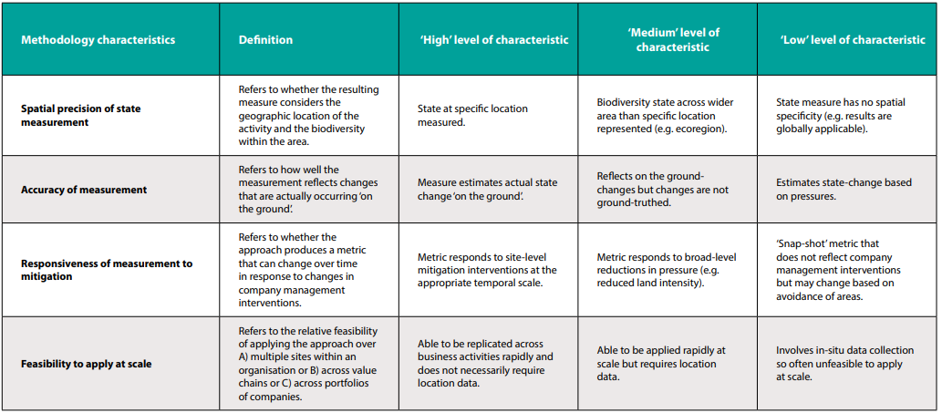
Overview general characteristics
Source: the Align recommendations
Notes:
This table gives an overview of the methodology characteristics for measuring biodiversity. It focusses on spatial precision, accuracy, responsiveness to mitigation and feasibility to apply at scale. These four characteristics are further explained in the next slides.
As an example, a company completing a site-level assessment would ideally use in-situ, primary biodiversity state data. This is because the spatial precision, accuracy of measurement and responsiveness to mitigation would all be ‘high’ and it is feasible for the company to collect data on site, and this would enable the company to monitor the effectiveness of their impact mitigation measures. Use of the same methodology, however, might mean that the feasibility to apply the methodology at scale, would be ‘low’ if applying the methodology across a wider range of sites, especially if data are not normalised across sites.
Contrasting this, a company wishing to assess impacts across the value chain is likely to choose a methodology with a ‘high’ feasibility to apply at scale to be able to compare and aggregate impacts (across value chains). This could be achieved through model based methodologies relying on sector-average pressure data. In turn, the same model based methodology may only provide a ‘medium’ responsiveness of measurement to mitigation, and ‘low’ spatial precision, and accuracy. The spatial precision and accuracy in this example could be improved through using primary directly measured pressure data to model state, rather than sector averages.

Slide 23





General characteristics of methodology
A. Spatial precision of measurement
Does it consider geographic location and biodiversity within the area?
Global
Country and region
Specific location
Low spatial precision
High spatial precision
Notes:
Let’s zoom in to ‘spatial precision’ of measurements. Data with low spatial precision is for example general data that differentiates between continents but does not hold location specific information. Country level data has already more spatial information. For example the map of Spain indicating areas with high nature value farmland. If we zoom in further, natural areas can be identified at provincial level. The highest spatial precision had location-specific information, for example at site level, considering the specificities of the species and ecosystems that are present.

Slide 24




General characteristics of methodology
B. Accuracy of measurement
How well the measurement reflects changes that are occurring on the ground
“Based on expert opinion, we predict the average abundance of birds at this site will have declined by 20% compared to a pristine reference”
Low accuracy
“Based on modelling data from other similar sites, we estimate the decline in average abundance of birds to be 40% compared to pristine reference”
57 % decline in average abundance at a site due to business operations
High accuracy
“Based on field surveys, we have monitored the average abundance of birds and show a decline of 60% compared to a pristine reference”
Notes:
The accuracy of measurements indicates how well the measurement reflects changes that are actually occurring on the ground. Low accuracy data will have larger error margins.
For example, there is in reality a 57 % decline in average abundance of birds at a site due to business operations (noise and people activity). The company notices the decline and wants to know how large the decline is. First, they predict the decline based on expert judgement with low accuracy. The prediction is a decline of 20% compared to a pristine reference. They investigate further and look for similar sites where also a decline in birds occurred. Using data from the other sites to feed a model, they can make the estimation that there is a 40% reduction. This model-approach gives a higher accuracy then the expert opinion. They hire an ecologist to perform field surveys. The monitoring revealed a decline of 60% compared to a pristine reference site. This last method gives the highest accuracy. The result is the closest to the reality at the time of survey. The accuracy may degrade over time, for example in a years time the survey may not reflect the conditions on the ground.

Slide 25
General characteristics of methodology
C. Responsiveness to company mitigation
Whether the approach produces a metric that can change over time in response to changes in the company
Low responsiveness
“Models based on modelling data from sites of similar high-level land use type"
"Spatial data layer from 5 years ago showing species ranges"
High responsiveness
“Based on field surveys, repeated every year during April - May”
Notes:
The responsiveness of a metric to a company's mitigation indicates whether the approach can identify changes over time in response to changes made by the company. Low responsiveness methodologies will not easily pick up on changes performed by the company. Methodologies of high responsiveness will pick up the changes.
For example, a model based on data from a few years old will have a low responsiveness to present or future changes over time. Methodologies that are repeated over time and include detailed assessments at the right scale (the same scale as the changes), will have high responsiveness.
There may be external factors that influence the data. For example the approach and metric may be responsive to the actions of third parties that influence biodiversity.

Slide 26
General characteristics of methodology
D. Feasibility to apply at scale
Relative feasibility to apply the approach over multiple sites/across value chains/across portfolios of companies
“Based on field surveys, repeated every year during April – May, for every site location”
Low feasibility to apply at scale
“Based on modelling data, can be applied at scale when location data is inputted”
“Based on models, no location data is required, can be replicated across business activities rapidly”
High feasibility to apply at scale
Notes:
The feasibility to apply at scale refers to the relative feasibility of applying the approach over multiple sites or across value chains or across portfolios of companies. Often, the methodologies with high spatial precision, high accuracy of measurement and/or high responsiveness are less feasibly to apply over whole value chains.

Slide 27
General principles for measurement and valuation processes
Relevance
The most relevant biodiversity impacts, risks and opportunities are considered including those impacts that are material for society and the business or financial institution and their stakeholders.
Rigour
Refers to the use of technical robust (from a scientific and economic perspective) information, data and methods that are up to date, accurate, complete and reduce uncertainty as far as possible.
Replicability
Means that all assumptions, estimates, data, caveats, and methods used are transparent, traceable, fully documented, and repeatable. This allows for eventual verification and audit, as required.
Consistency
All data and methods used for an assessment are compatible with each other and within the scope of the analysis, which depend on the overall objective and expected business application.
Adapted from: Capitals Coalition (2016). Natural Capital Protocol. https://capitalscoalition.org/capitals-approach/natural-capital-protocol/
Source: the Align recommendations
Notes:
These guiding principles should underpin any measurement and valuation process: relevance, rigor, replicability and consistency. They are designed to ensure appropriate methods, metrics and data are used to fit the intended business application. These principles should be applied to all business contexts and all levels of maturity of biodiversity assessment.
Adapted from: Capitals Coalition (2016). Natural Capital Protocol. https://capitalscoalition.org/capitals-approach/natural-capital-protocol/

Slide 28
Technical criteria for how to measure biodiversity at two levels:
Good practice technical criteria
Should be followed by every company
Are scientifically robust & ensure a significant change in how biodiversity is measured (i.e., compared to ‘business as usual’).
Best practice technical criteria
Should be followed for highly material impacts
Represent a ‘direction of travel’ for biodiversity measurement
Encompass a more comprehensive and robust assessment
Notes:
To ensure the general principles of each methodology are met, the data collected must be robust. To achieve robust data collection, technical criteria for ‘good’ and ‘best’ practice are described for species and ecosystems . Good practice criteria should be followed by every company, independent of sector, size and level of materiality of impacts (technical criteria don’t apply to non-material impacts). They are scientifically robust and, if adopted across more businesses, will ensure a significant change in how biodiversity is measured (i.e., compared to ‘business as usual’).
Best practice criteria should be followed for highly material impacts. They represent a direction of travel for biodiversity measurement and encompass a more comprehensive and robust assessment.

Slide 29
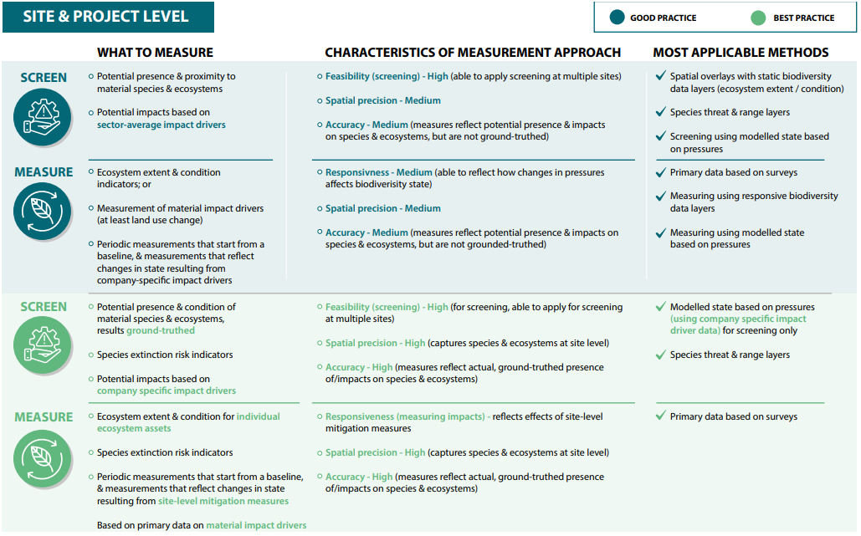
Source: the Align recommendations
Align Recommendations, 2022
Notes:
The guidance builds upon the good and best practice outlined in the align guidance.
To recap, the Align recommendations set out criteria for screening potential impacts to inform risk and opportunity assessments and measuring realised impacts on biodiversity on the ground. These criteria are split into ‘good practice’, which are suitably robust and represent a step change from business as usual, and ‘best practice’ which reflect a ‘direction of travel’ for biodiversity measurement.
Fictional case studies applying these recommendations can be found in the site-level implementation guidance, available at: https://capitalscoalition.org/wp-content/uploads/2023/10/Align_site_level_implementation_guidance.pdf

Slide 30
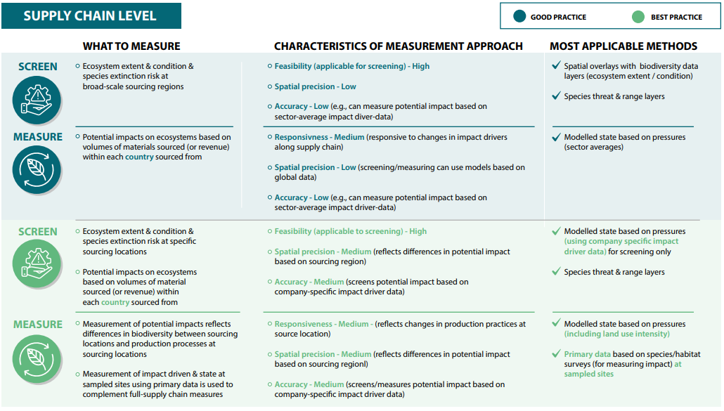
Source: the Align recommendations
Align Recommendations, 2022
Notes:
For supply chains
Approaches available for measuring impacts and dependencies on biodiversity of supply chains are likely to rely more on estimates and models than those applied for direct operations, due to the lower availability of spatially-specific and directly measured information. Direct on-ground measurement of biodiversity state for accurate and precise measurement of actual impacts is unlikely to be used for assessing supply chain impacts and is often only possible for small subsections of the supply chain. It is more common and realistic to assess the potential impacts of supply chains, using lower accuracy and precision screening. For specific production sites that are known within supply chains, site-based approaches can be applied.
Fictional case studies implemented these recommendations can be found in the supply chain implementation guidance, available at https://capitalscoalition.org/wp-content/uploads/2023/10/Align_supply_level_impementation_guidance.pdf

Slide 31
Activity
Notes:
Let’s put these ideas into practice, and start to think about what measurement characteristics might be required for different decision contexts.

Slide 32
‘Our business has lots of sites, and we need to identify a subset of priority sites to start with’
This requires repeated measurement over time with an approach that has high spatial specificity
Business uses field surveys and qualitative surveys with stakeholders to assess the presence of threatened species
Business learns that whilst GHG emissions from sites have an impact, the most important driver is the direct land use
‘We want to confirm the species and ecosystems present at our priority sites’
This can apply an approach to assessing potential impact that doesn’t require high levels of accuracy or precision
Business creates a shortlist of highest priority sites because they overlap with Key Biodiversity Areas. They prioritise these sites in their target setting.
Business reports that net gain has been achieved for key ecosystem types present at the site
‘We need to also estimate the potential impacts of indirect pressures such as GHG emissions to inform mitigation’
This requires an approach that has high feasibility to apply at scale relatively quickly
Business uses an accounting framework to structure metrics of ecosystem extent and condition over time, derived from field surveys and remote sensing
Business confirms the list of threatened species that likely occur on the sites
‘We need to demonstrate in our reports whether our target of net gain has been achieved at our priority sites’
This requires an approach with high levels of accuracy and spatial precision, but doesn’t need to track change over time
Business uses model-based footprinting to estimate impact of GHG emissions and water pollution
Business overlays sites with global layers of Threatened species, Ecosystem Integrity and Key Biodiversity Areas
Notes:
The slide above outlines four objectives of assessment that a site manager is considering (first column). For each, match the objective to the most relevant set of characteristics (second column), a potentially relevant measurement approach (third column), and lastly the actions taken as a result of measurement (fourth column). Click through to the next slide to reveal a resolved solution.

Slide 33
‘Our business has lots of sites, and we need to identify a subset of priority sites to start with’
This requires an approach that has high feasibility to apply at scale relatively quickly
Business overlays sites with global layers of Threatened species, Ecosystem Integrity and Key Biodiversity Areas
Business creates a shortlist of highest priority sites because they overlap with Key Biodiversity Areas. They prioritise these sites in their target setting.
‘We want to confirm the species and ecosystems present at our priority sites’
This requires an approach with high levels of accuracy and spatial precision, but doesn’t need to track change over time
Business uses field surveys and qualitative surveys with stakeholders to assess the presence of threatened species
Business confirms the list of threatened species that likely occur on the sites
‘We need to also estimate the potential impacts of indirect pressures such as GHG emissions to inform mitigation’
This can apply an approach to assessing potential impact that doesn’t require high levels of accuracy or precision
Business uses model-based footprinting to estimate impact of GHG emissions and water pollution
Business learns that whilst GHG emissions from sites have an impact, the most important driver is the direct land use
‘We need to demonstrate in our reports whether our target of net gain has been achieved at our priority sites’
This requires repeated measurement over time with an approach that has high spatial specificity
Business uses an accounting framework to structure metrics of ecosystem extent and condition over time, derived from field surveys and remote sensing
Business reports that net gain has been achieved for key ecosystem types present at the site
Notes:
Here is a potential solution- does this match what you came up with?

Slide 34
‘We need to understand which of the commodities we source has the highest potential impacts on biodiversity
This requires an approach with relatively high levels of spatial precision, but doesn’t need to track change over time
Business uses a model-based footprinting approach that has factors for different land use intensities and remote sensing
Business gains robust and transparent evidence that engaging with suppliers on regenerative practice scan contribute to biodiversity uplift
‘We want to understand how sourcing from different regions using different production practices may affect our total footprint’
This requires an approach with high spatial precision and can track change over time
Business estimates its impacts on biodiversity based on its spend on different commodities using an input-output model and model-based footprinting approach
Business identifies the sourcing landscape holds some of the last remaining patches of a threatened ecosystem type
‘We’ve identified the regions we source from, and want to understand their importance for biodiversity’
This requires a screening approach with high feasibility to apply at scale, and can have relatively low accuracy
Business uses field surveys and qualitative surveys with stakeholders to assess trends in species abundance
Business understands that sourcing from suppliers using a different method of production reduces its biodiversity footprint from water use
‘We’ve engaged with a group of producers to support a move towards regenerative practices, and want to understand the impacts on biodiversity at the farm level’
This requires a screening approach that has ability to reflect the potential impacts of different production practices
Business overlays sourcing regions with global data sets on Threatened species, Ecosystem Integrity and designated areas
Business identifies a shortlist of commodities to begin developing a biodiversity strategy around
Notes:
Now let’s repeat the exercise, but in the context of assessing supply chains. Click through to the next slide to reveal a resolved board.

Slide 35
‘We need to understand which of the commodities we source has the highest potential impacts on biodiversity
This requires a screening approach with high feasibility to apply at scale, and can have relatively low accuracy
Business estimates its impacts on biodiversity based on its spend on different commodities using an input-output model and model-based footprinting approach
Business identifies a shortlist of commodities to begin developing a biodiversity strategy around
‘We want to understand how sourcing from different regions using different production practices may affect our total footprint’
This requires a screening approach that has ability to reflect the potential impacts of different production practices
Business uses a model-based footprinting approach that has factors for different land use intensities and remote sensing
Business understands that sourcing from suppliers using a different method of production reduces its biodiversity footprint from water use
‘We’ve identified the regions we source from, and want to understand their importance for biodiversity’
This requires an approach with relatively high levels of spatial precision, but doesn’t need to track change over time
Business overlays sourcing regions with global data sets on Threatened species, Ecosystem Integrity and designated areas
Business identifies the sourcing landscape holds some of the last remaining patches of a threatened ecosystem type
‘We’ve engaged with a group of producers to support a move towards regenerative practices, and want to understand the impacts on biodiversity at the farm level’
This requires an approach with high spatial precision and can track change over time
Business uses field surveys and qualitative surveys with stakeholders to assess trends in species abundance
Business gains robust and transparent evidence that engaging with suppliers on regenerative practice scan contribute to biodiversity uplift
Notes:
Here is a potential solution- does this match what you came up with?

Slide 36
Dependencies

Slide 37

Measurement of dependencies
Measurement of dependencies is less evolved than impact measurement.
Measurements of biodiversity dependencies involves understanding:
  the ecosystem services that are material to the business and
  which ecosystem types are most likely to provide those services across value chains
An analysis of the current and future extent and condition of these ecosystems will highlight how business dependencies may become material issues in the future, referred to as 'dynamic materiality'.
Solely focussing on ecosystem service flows can lead to poor business decision making as risks associated with declining capacity of ecosystems to deliver flows into the future are not considered.
Notes:
Businesses are vulnerable to the operational and systemic risks associated with declines in the state of biodiversity. Measuring business dependencies on biodiversity is needed to assess and manage these risks and guide positive action, although this is less evolved than measuring impacts, with fewer established measurement approaches, metrics and tools

Slide 38
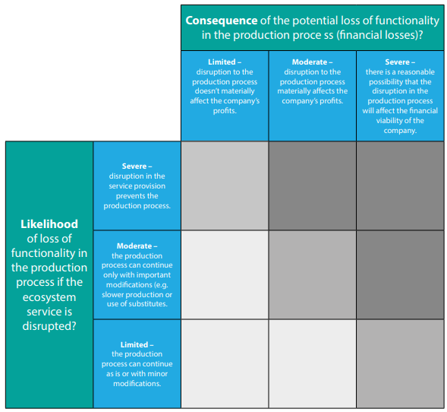
Measurement of dependencies
Identification of ecosystem service dependencies should use a structured framework
Priority filters can be used to identify the materiality of ecosystem service dependencies based on potential loss in production processes and associated financial losses
Source: the Align recommendations
Notes:
Identification of ecosystem service dependencies should use a structured framework
Measuring biodiversity dependencies involves understanding which ecosystem services are material to the business, and which ecosystem types are most likely to be providing those services across business value chains. This allows an understanding of how current and future trends in the extent and condition of ecosystems may affect business dependencies on ecosystem services.
Priority filters can be used to identify the materiality of ecosystem service dependencies based on potential loss in production processes and associated financial losses
To assess materiality of business dependencies on ecosystem services, two factors can be considered in relation to the role of ecosystem services in the production processes of a business’ operations.

Slide 39

Content check-in
Consider the sector you are in and your business model
What are the main areas of your business that are likely to depend on nature? For example do you rely on inputs of biomass or clean water? Are you operating in areas that might be prone to flooding and other hazards?
How might your business be affected if these services were disrupted?
What areas of your business may dependencies on nature be less obvious/more hidden?

Slide 40
Valuation

Slide 41





Valuation
Biodiversity has multiple values, all of which should be considered in decision making processes. Valuation assessment should be underpinned by robust measurements of the underlying state of nature.
Direct value
Value from direct use of natural resource
Non-use value
Value from knowing the existence of biodiversity, and from knowing that other people, and future generations, can benefit from biodiversity
Underpinning value
Value from role of biodiversity in supporting ecosystem service delivery
Insurance value
Value from the provision of options for the delivery of services in an uncertain future
Intrinsic value
The value that is independent from any human use, associated with the moral right of living things to exist
Notes:
Valuation refers to the process of estimating the relative importance, worth, or usefulness of biodiversity to people (or to a business), in a particular context. Valuation may involve qualitative, quantitative, or monetary approaches, or a combination of these.
The Align recommendations provide a set of key principles to ensure the robustness of valuation assessments. This includes to consider all types of value in assessments, and that it should be clear which types of biodiversity values are assessed and which are omitted from assessments, with acknowledgements that intrinsic and non-use values cannot be captured in any total economic value approach. Further information on methods for valuation can be found in the recommendations document.
#good use of the term ‘methods’ in the notes here $that is because methodologies are specific protocols or developed approaches, methods a more general term
#text Underpinning value not totally clear. A word missing? Or word order? $added clarity
#A slide on valuation methods, qual/quant/monetary, with “strengths and weaknesses” (i.e. appropriate use cases) would be welcome $project team feel this is out of scope of what the Align recommendations cover

Slide 42
Content check-in
What is meant by nature having ‘intrinsic value’
A. Nature has value that is independent from any human use
B. Nature underpins the provision of ecosystem services
C. Nature has a monetary value within the economy

Slide 43
Content check-in
What is meant by nature having ‘intrinsic value’
A. Nature has value that is independent from any human use
B. Nature underpins the provision of ecosystem services
C. Nature has a monetary value within the economy
Notes:
Did you get it right? Intrinsic values capture the value of nature that can’t be related to its use by humans

Slide 44
Summary
Through this introductory module, you have covered:
An overview of the Align recommendations, and the core decision making contexts for measurement and valuation
The characteristics of the methodologies used to measure state and change in state, such as population counts and spatial data layers.
The difference between primary data, secondary state data and modelled pressure-state data.
The factors to consider in selecting a measurement approach including spatial precision, accuracy, responsiveness to change and feasibility to apply at scale.
Introduction to measurement business dependencies and the multiple values of biodiversity
https://capitalscoalition.org/project/align/

Slide 45


Further training modules
Two further training modules have been developed by the Align project, to focus in on two areas in more detail:

Slide 46
These materials have been prepared by:
Jolien Verhelst (Arcadis)
Jacob Bedford (UNEP-WCMC)
Notes:
You’ve now reached the end of this introductory module on the Align recommendations. Please explore the guidance linked, and think how they could be used to support your sustainability journey. Please visit the Align project website for further resources and outputs from the project, including further training modules.

